Slide 1
Industry Engagement Session
Sophie Renshaw
Senior QA Engineer – AI Engineering
Workhuman

Slide 2





About Me & my career (so far)
Sophie Renshaw
BSc in Applied Computing from SETU
MSc in Artificial Intelligence from DCU
Various QA & AI Engineer roles across Telecommunications, Finance & HR industries
Senior QA Engineer for Workhuman in AI Engineering Team

Slide 3
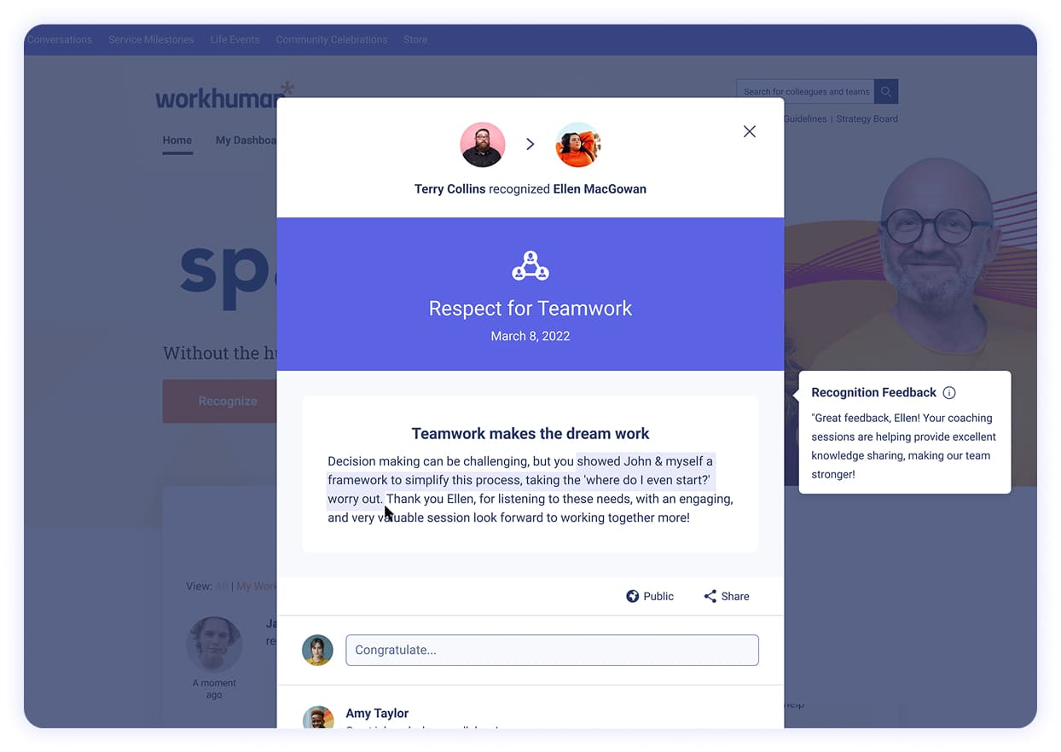
About Workhuman
Make Work More Human
Worlds #1 rated employee recognition platform with the goal of celebrating good work & building culture.
Recognition moment every 2 seconds for over 7.5 million employees across 180 countries – that’s a lot of data!!
Tools that include:
Peer-to-peer recognition
Service Milestones
Community Celebrations
Life Events
Conversations
Human Intelligence & Workhuman IQ
https://www.workhuman.com/company/careers/
Notes:
At Workhuman, our mission is simple: to make work more human.
HI & WHIQ - recognition advisor, culture hub & reward stories, AI Assistant

Slide 4
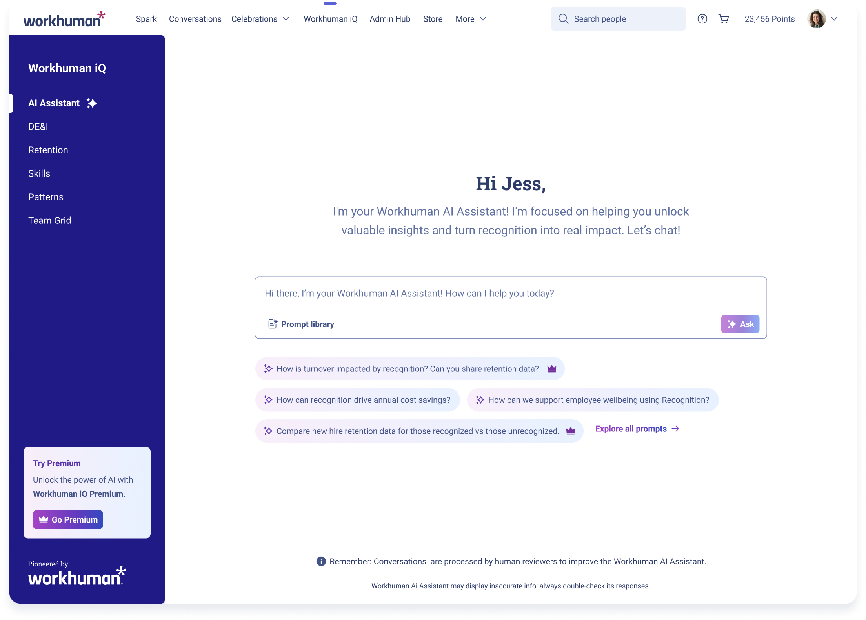
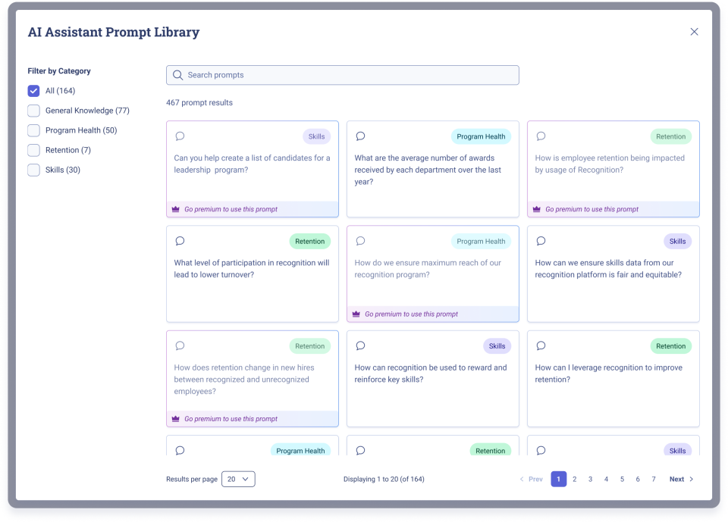
AI Engineering at Workhuman
Workhuman’s AI Assistant
Built on 25 years of Workhuman recognition data & linguistic research
Helps leaders understand what’s working, what’s not and what to do next.
Learn about the people, culture & company.
AI that enhances humanity, not replaces it.
Real-time answers on:
How to improve program reach & performance
Where hidden skills & connections exist
How recognition is driving measurable business outcomes
Notes:
In large organisations, recognition data is full of powerful insights — yet too often they remain hidden, unseen, and unused. What if AI could unlock the human stories behind recognition? What if it could help organisations truly understand and celebrate their people?
The first platform purpose-built for recognition data. It transforms millions of recognition moments into real-time, evidence-based insights.
Leaders can ask questions like, ‘Who’s driving collaboration?’ or ‘What recognition behaviours predict higher retention?’ And instantly see actionable insights and visualizations — from skill profiles to retention risk graphs and DE&I trends — helping them act faster, more fairly, and more strategically.
The result? More authentic recognition, stronger engagement, and cultures where people feel truly seen and valued. Every recognition moment unlocks the full potential of people, because, when work is more human, everything thrives.

Slide 5
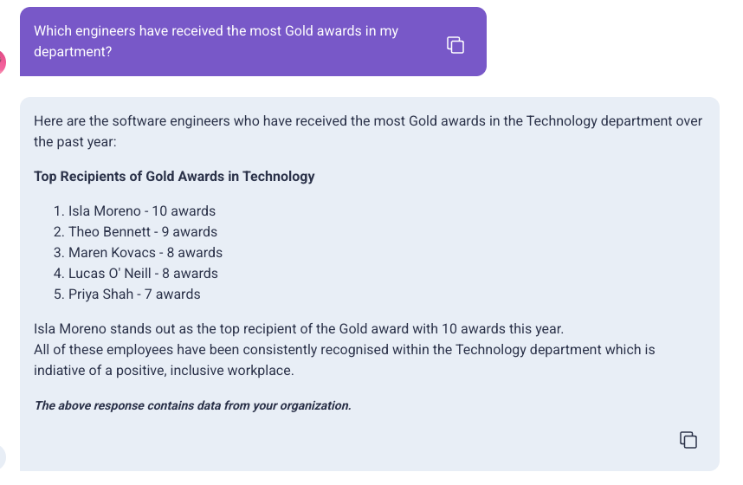
AI Assistant
Technologies & My Role
Technologies
Advanced LLMs
Retrieval-Augmented Generation (RAG)
AI Agents
Semantic Similarity & Language Model Routing
SQL/Redshift Database
Typescript FE / Python BE
AI Assistant Testing
Automated Evals & LLM-as-a-Judge
Exploratory Testing
Gen AI QA Best Practices
Responsible AI Principles
Notes:
Combines advanced language models, retrieval-augmented generation, and responsible AI principles.
Prompt – use LLM to get dimensions
Use Semantic Similarity or LLM Routing to decide which agent should handle this prompt (program health agent)
Generate SQL query to pull information from database (software engineers, technology department, gold awards)
And/or use semantic matching to get required information from a retrieval-augmented generation system – external knowledge base to get specific information relevant to the prompt, improving factual accuracy & providing domain specific info.
Insert the results from the SQL query into our system prompt & pass this to the LLM to generate final response for the user.
Wrapped in a Typescript frontend.

